Slide 1
L8 –SNA
Musica Supriya

Slide 2
Visualizing Network features
Labels
Weights and node properties
Size shape and color

Slide 3
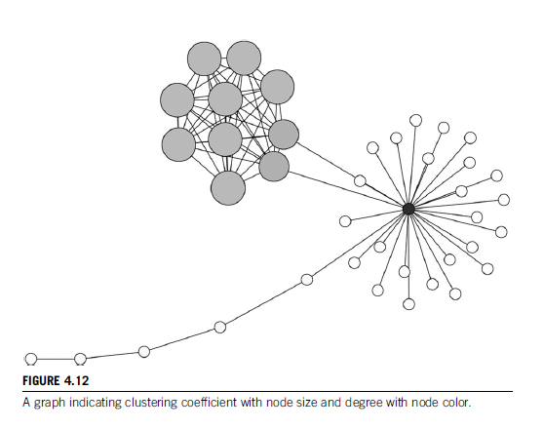

Slide 4
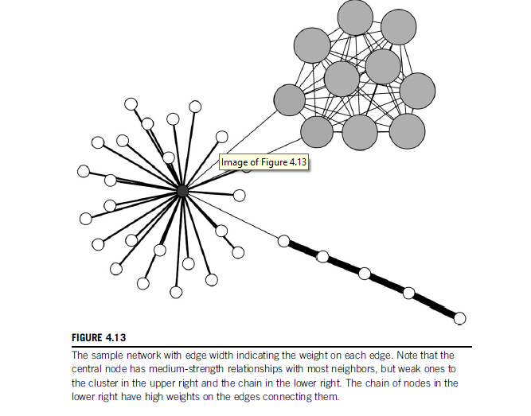

Slide 5
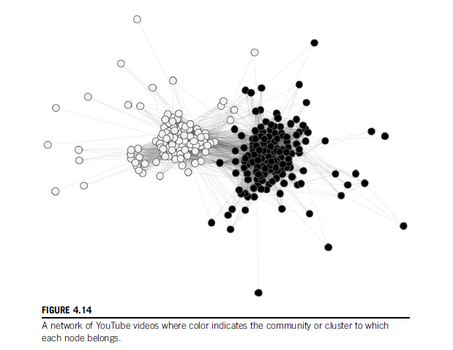

Slide 6
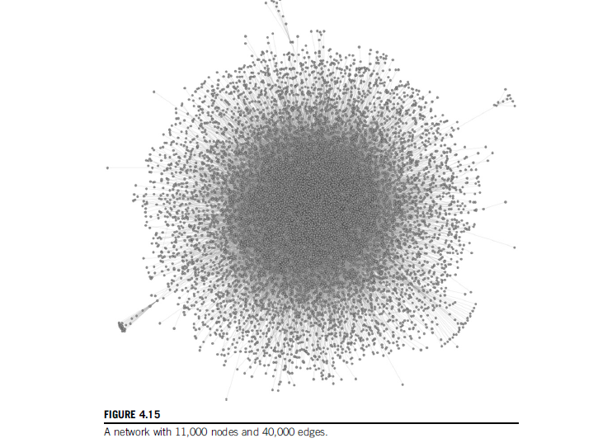

Slide 7
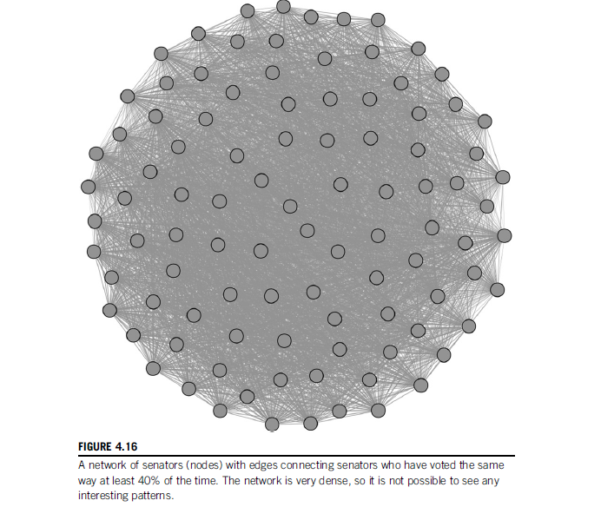

Slide 8
Scale Issues
Wider Network, poor visualization
Density
Solution?
Filtering for visual patterns

Slide 9
Graph Simplification
Techniques
Grouping cluster of nodes into a single node
Representing edges between clusters as a single edge
Representing structural patterns as representative shapes
Showing only part of the graph

Slide 10
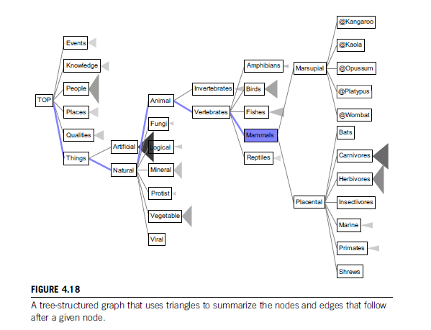

Slide 11
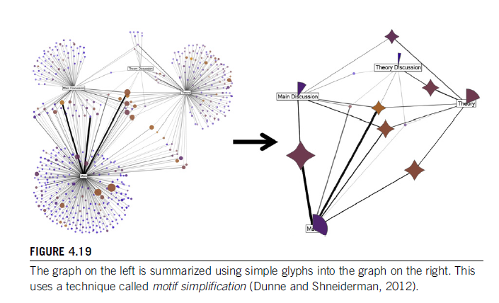
Motif Simplification

Slide 12
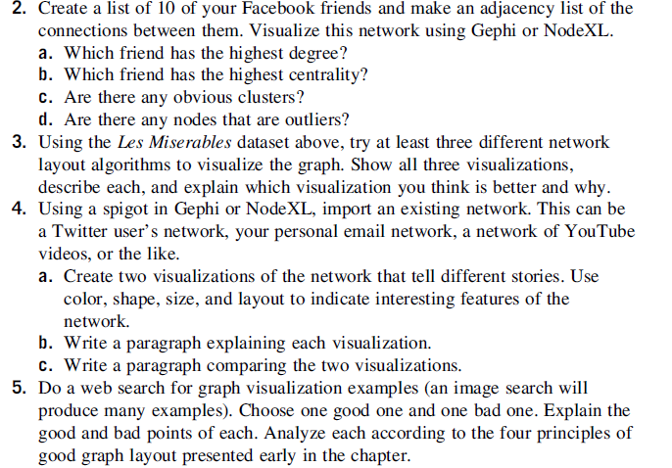

Slide 13
Tie Strength
What are ties?
Tie Stregth?
Strong and weak ties
Absent ties
Feature of strong and weak ties

Slide 14
Measuring tie strength
4 Characteristics:
Time
Emotional intensity
Intimacy
Reciprocal Services

Slide 15
What other factors influence?
Structural
Social Distance
Emotional Support

Slide 16
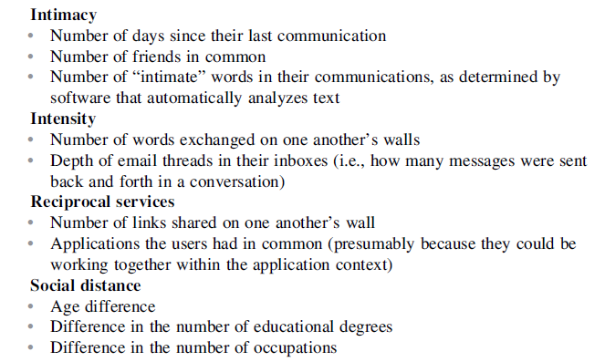
A case study on the variables Gilbert and Karahalio used to measure tie strength:

Slide 17
How do we measure these factors?
Context
Information available etc

Slide 18
Tie strength and network structure
Are these related?
What do you infer if you and your friend have many mutual friends?
How do you represent a strog tie in a network?

Slide 19
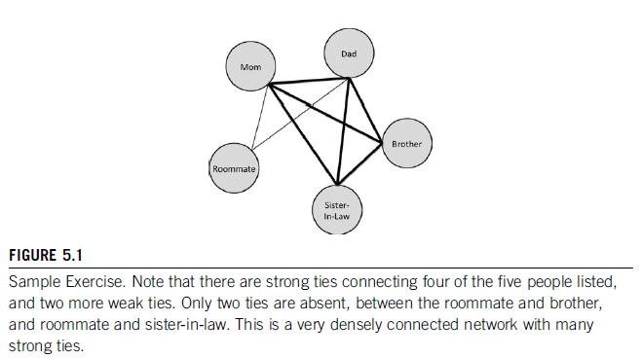

Slide 20
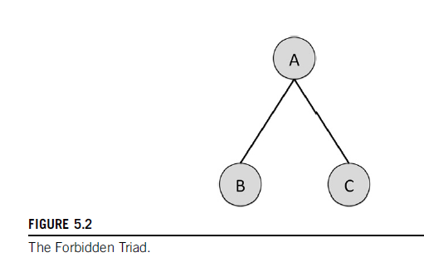
Forbidden Triad

Slide 21
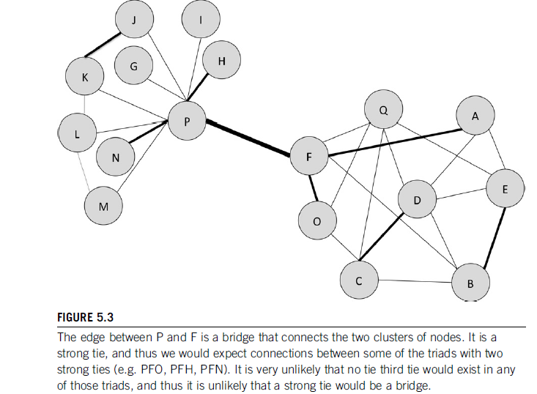

Slide 22
No strong tie is a bridge – Granovetter
Is it true?

